Slide 1

Introduction to Class B Audio Amplifiers :
Class B amplifiers conduct for only 180 degrees of the input signal cycle. They offer higher efficiency than Class A amps and are often used in push-pull configurations. Other amplifier classes include A, AB, C, and D, each with unique features and applications.

Slide 2
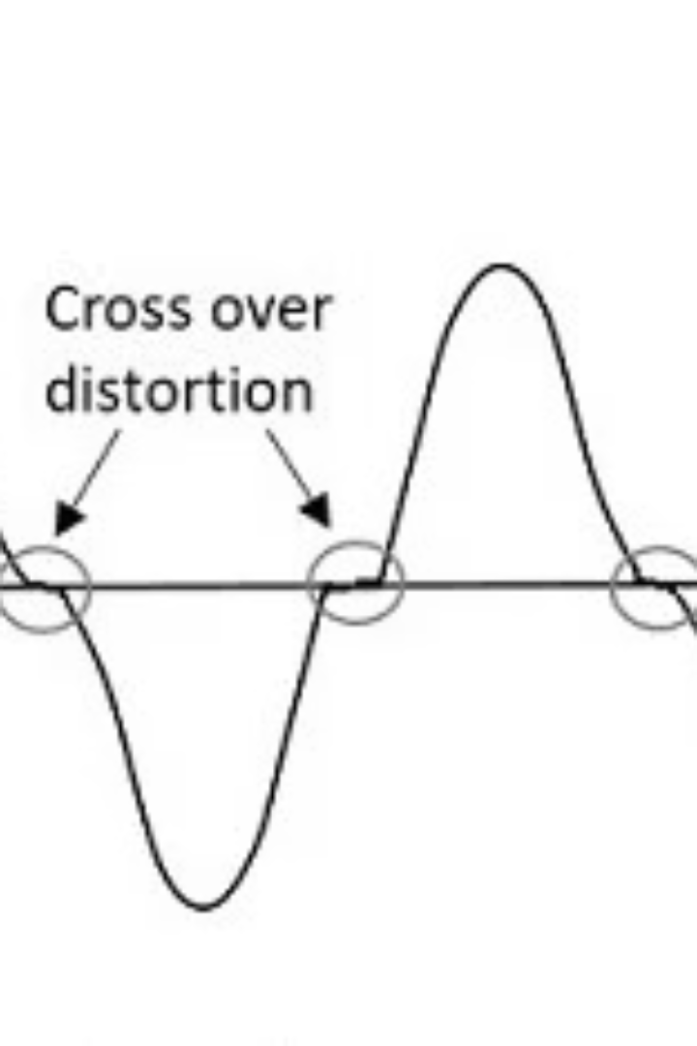
Characteristics of Class B Amplifiers:
Conduction Angle
180 degrees per transistor
Biasing
Cutoff bias with minimal quiescent current
Output Signal
Notable crossover distortion
Efficiency
Up to 78.5% theoretical max
Circuit Configuration
Push-pull with complementary NPN/PNP transistors

Slide 3
Advantages and Disadvantages:
Advantages:
Disadvantages :
High power efficiency
Significant crossover distortion
Reduced heat dissipation
Requires push-pull design complexity
Smaller heat sinks required
Higher total harmonic distortion than Class A
Class B amps are cost-effective yet need distortion control techniques.

Slide 4




Applications of Class B Amplifiers:
Car Audio Systems
RF Amplification
Servo Motor Control
Public Address Systems
Efficient power delivery for vehicle speakers.
Signal boosting in radio transmitters.
Stable driving of motors with controlled power.
Clear amplified sound for large areas.

Slide 5
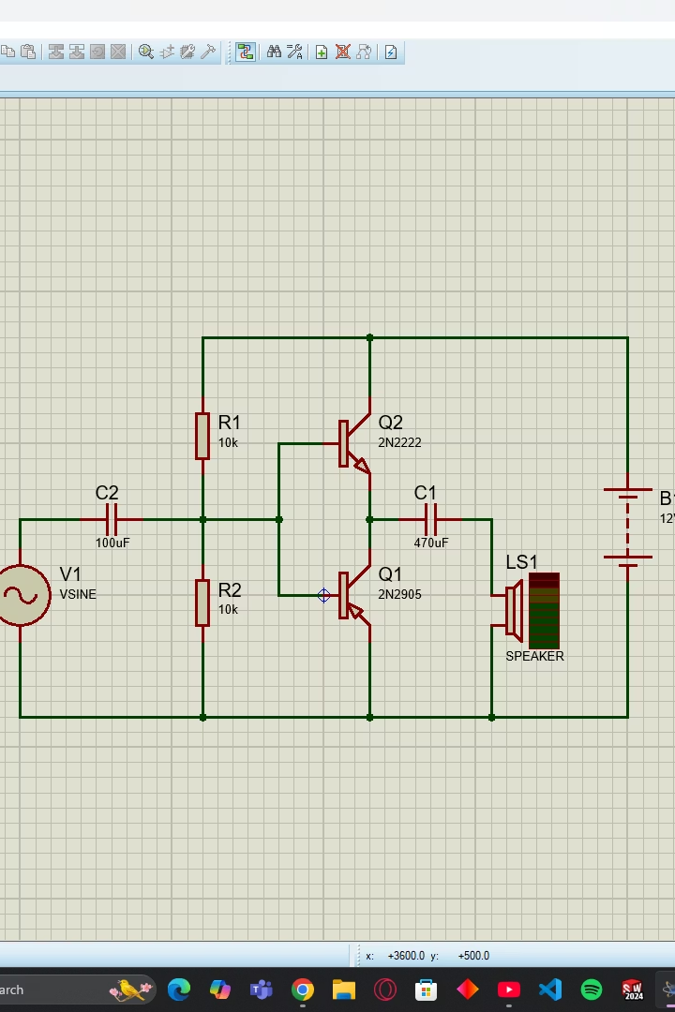
Simulation Setup: Class B Push-Pull Amplifier
Circuit Diagram:
Complementary pair of NPN and PNP transistors
Simulation Software:
proteus
Input Signal:
1 kHz sine wave at 1 V amplitude
Load Resistance:
Typically an 8-ohm speaker load

Slide 6
Simulation: Results:
1
Simulation:
1
Output Waveform:
Calculated based on input and output power data.
Crossover distortion is clearly visible near the zero crossing.
2
Amplification:
2
Distortion Analysis:
The first stage amplifies the voltage to the required level for the second stage.
Distortion occurs around zero due to the transistor threshold voltage (0.7 V).
The second stage boosts the current for the speaker.

Slide 7
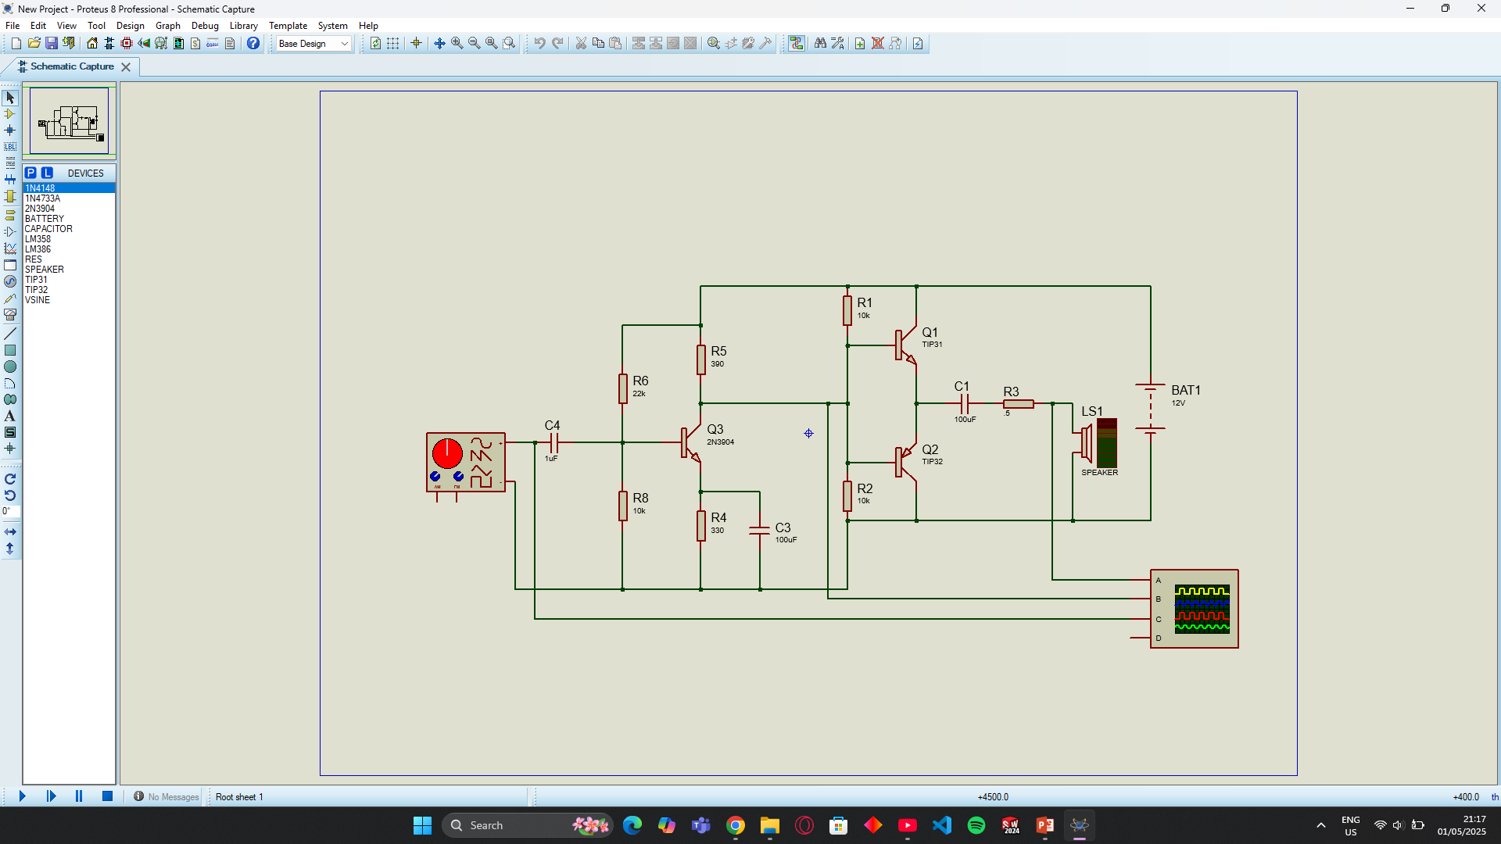
Simulation:

Slide 8
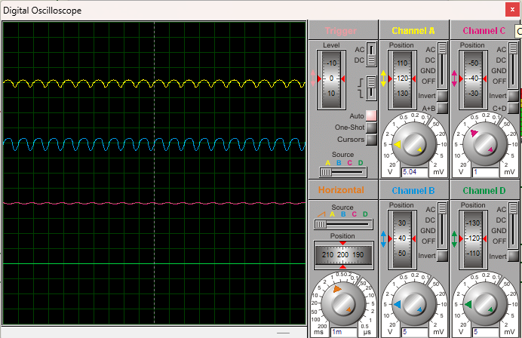
Results:

Slide 9





Challenges and reasoning:
Crossover Distortion
one of the class b charactaristics
No output
very low input voltage
Coupling capacitor charging
DC leaking from the preamp stage
Thermal management
due to high current and power in the circuit

Slide 10
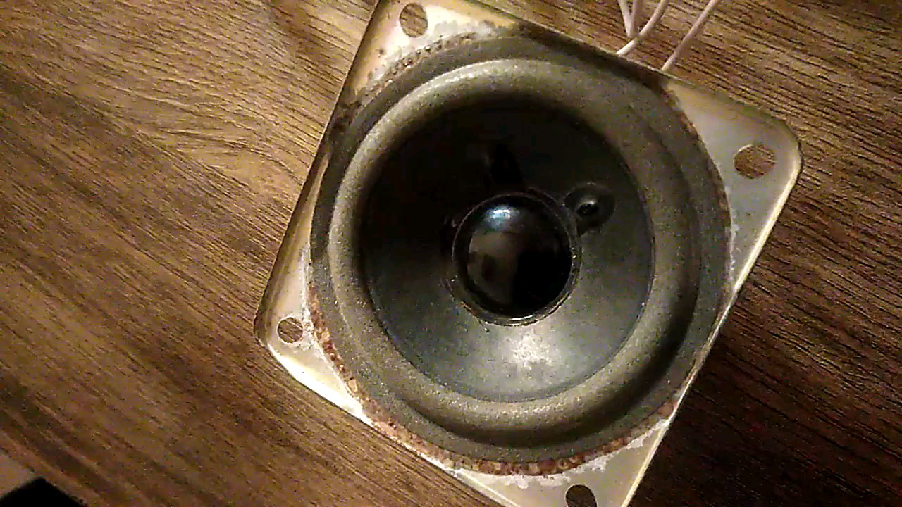
Video of the circuit in action:
The sound is amplified just as expected
And a bit distorted cause of the crossover distortion as explained before

Slide 11
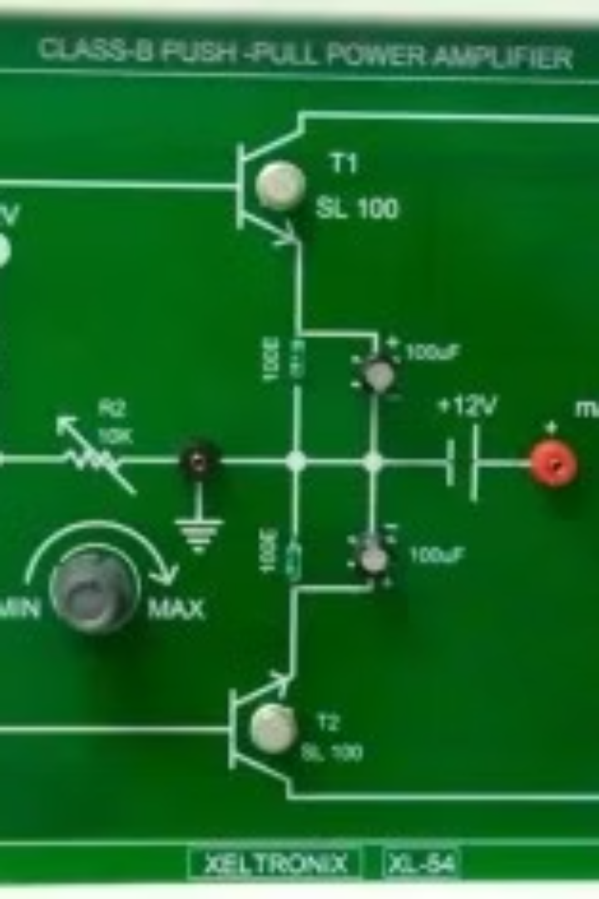
Conclusion:
Class B amplifiers provide high efficiency in audio applications.
Careful design reduces crossover distortion significantly.
Emerging DSP integration helps improve sound quality further.

Slide 12





Meet the Development Team:
Tasneem Abdelrahman
Hany Ehab
.
Menna-elrahman Mohamed

